Slide 1
Project 4
Rekha Kondeti
Graduate

Slide 2
Task-1
Need to build top 3 ensemble classifiers using different types of discriminant analysis classifiers (‘linear', ’quadratic’, ‘diagLinear’, and ‘diagQuadratic’), and different SVMs (by changing kernel type and their parameters (Gaussian, polynomial, and linear)
Also plot ROC curves before and after fusion

Slide 3
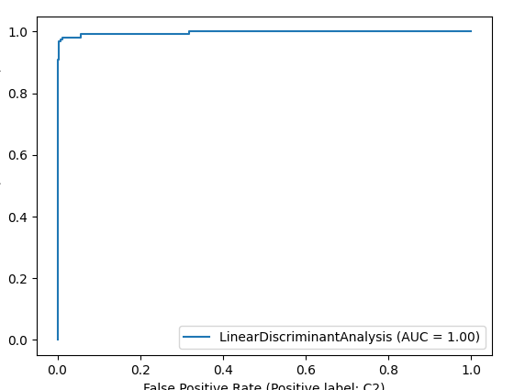
Roc and Classification matrix for LDA
Training:

Slide 4
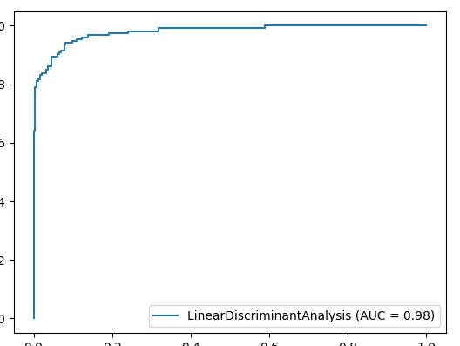
Roc and Classification matrix for DLDA
Training:

Slide 5
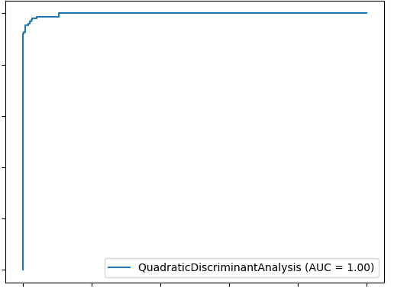
Roc and Classification matrix for QDA
Training:

Slide 6
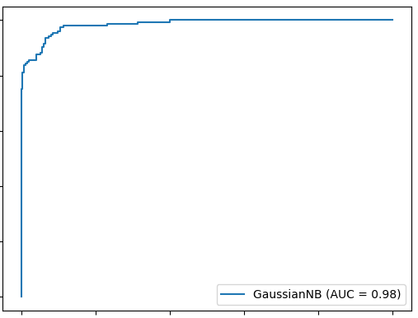
Roc and Classification matrix for DQDA
Training:

Slide 7
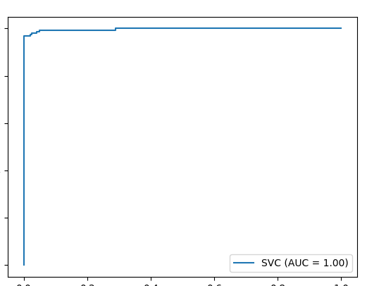
Roc and Classification matrix for #For rbf kernel: Roc and Classification matrix for #For rbf kernel: Roc and Classification matrix for #For rbf kernel: Roc for Rbf kernel:
Training:

Slide 8
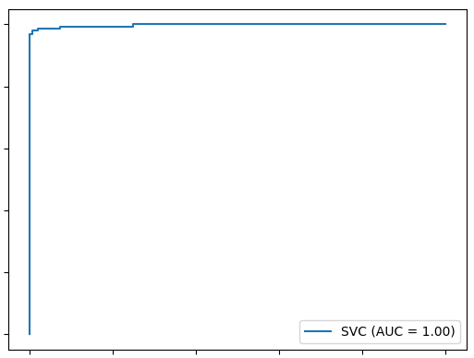
Roc and Classification matrix for #For rbf kernel: Roc and Classification matrix for #For rbf kernel: Roc and Classification matrix for #For rbf kernel: Roc for Linear kernel
Training:

Slide 9
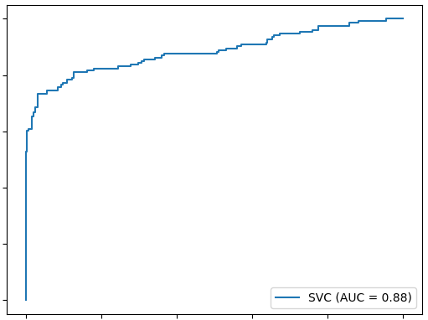
Roc and Classification matrix for #For rbf kernel: Roc and Classification matrix for #For rbf kernel: Roc and Classification matrix for #For rbf kernel: Roc for polynomial kernel degree 2
Training:

Slide 10
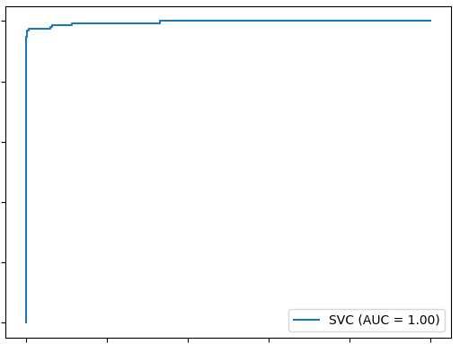
Roc and Classification matrix for #For rbf kernel: Roc and Classification matrix for #For rbf kernel: Roc and Classification matrix for #For rbf kernel: Roc for polynomial kernel degree 3
Training:

Slide 11
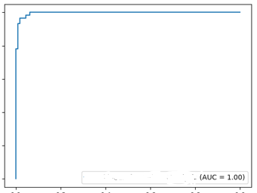
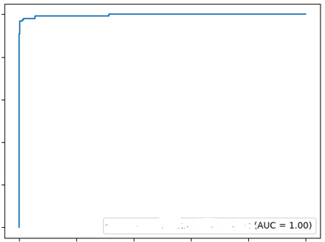
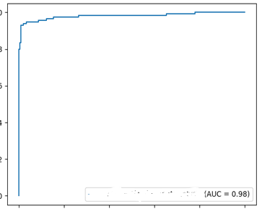
Roc curves of 3 ensemble models of Task:1
1
Ensemble gives more accuracy than individual models.
Minmaxscaler():It gives Normalization of values
Accuracies of these ensemble models are 94%,92% and 96%.

Slide 12
Task 2
Using the concept of stack generalization ,need to build a classifier and show ROC curves before and after fusion

Slide 13
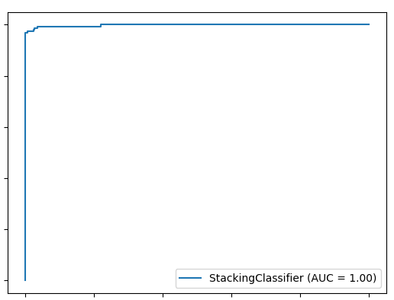
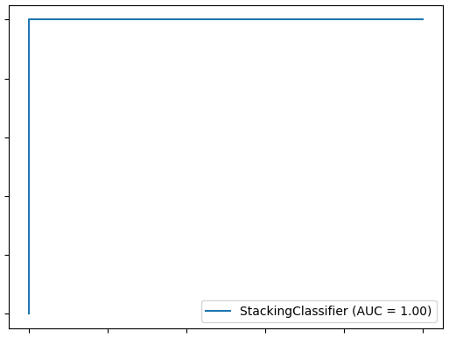
Stacking ROC’s
Testing:
Training:

Slide 14
Conclusion
Accuracy of Stack model is 0.9766081871345029 ie 97%.It has the highest accuracy when compared to all other models
Execution of task2 is taking more time when compared to task 1 as it must take outputs of classifiers and consider as input in Stacking.
When compared to accuracies of task1 and task2, task2 has highest accuracy
This shows that the accuracy of stacking gives achieves the highest accuracy than any other model taken alone

